Slide 1


Demo: Running a
Cassandra cluster with Docker
EPAM BIG DATA MEETUP
Attila Szucs
attila_szucs@epam.com
JUNE 2, 2016

Slide 2
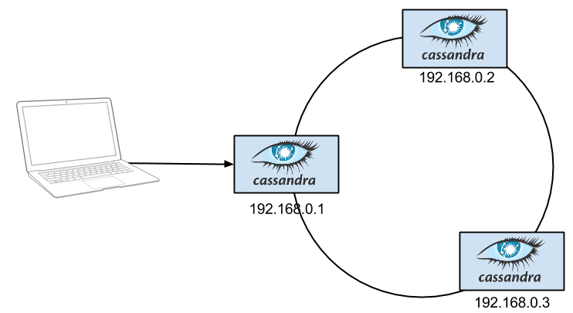
GOAL – EXPERIMENT WITH CASSANDRA
For each node:
Provision Linux machines
Install Cassandra
Configure Cassandra to form a cluster

Slide 3
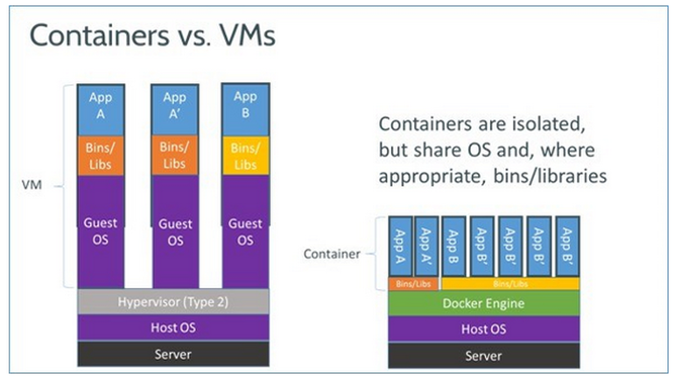
DOCKER – IN A peaNUTSHELL
Lightweight virtualization framework

Slide 4


DOCKER – BENEFITS (for us)
Incredibly fast container creation
Sub-second container creation time
No need for guest OS
Copy On Write
Rich public library of images
Similar to DEB packages, MVN repositories,
NuGet packages, NPM packages, etc…

Slide 5

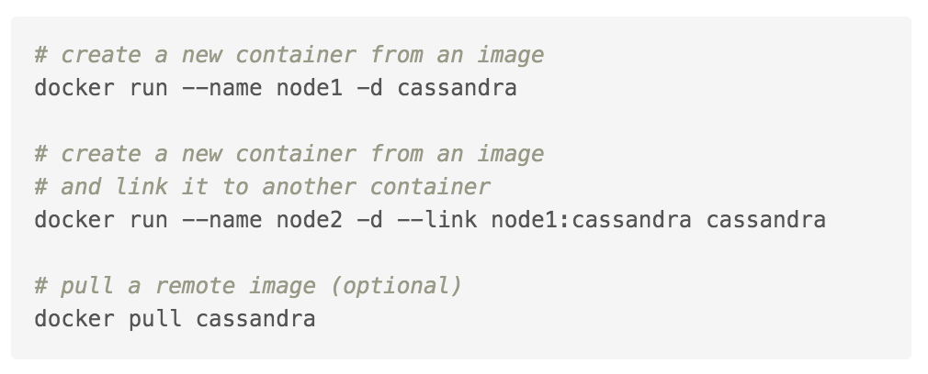
DEMO #1 – CASSANDRA OFFICIAL IMAGE
All demos are available under
http://github.com/medvekoma/docker-cassandra
Name | What is it? | Similar to…
cassandra | image | type (.class)
node1 | container | instance
Dockerfile | docker image script file | type definition (.java)

Slide 6
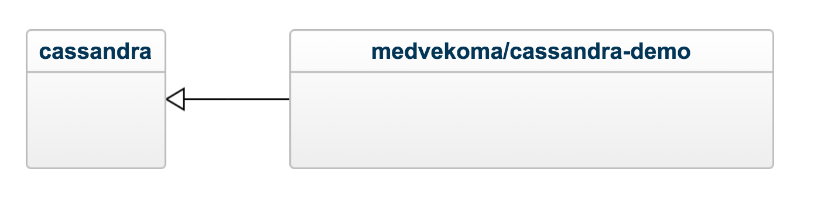
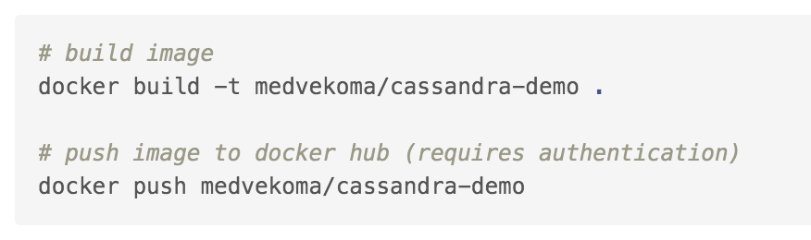
DEMO #2 – CUSTOM IMAGE
Treat images as “immutable”
Create a new image if you need new files or applications
Official
image
User image
(treat it with suspicion :))
FROM cassandra:3.3
COPY bin/* /demo/
RUN apt-get update && apt-get install -y jq

Slide 7

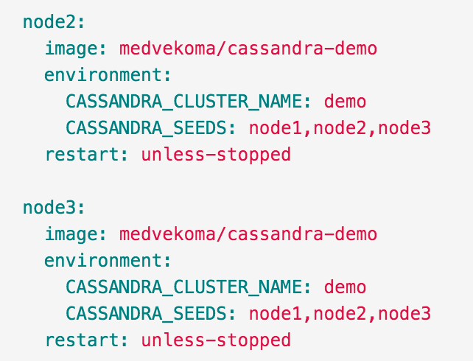
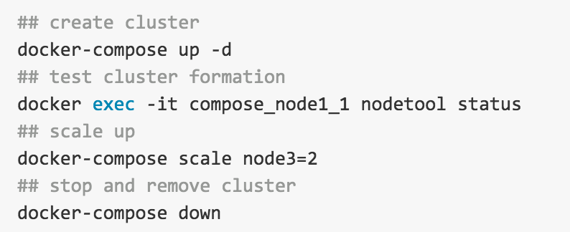
Demo #3 – Docker Compose
Still there are several steps
Let’s combine the containers

Slide 8
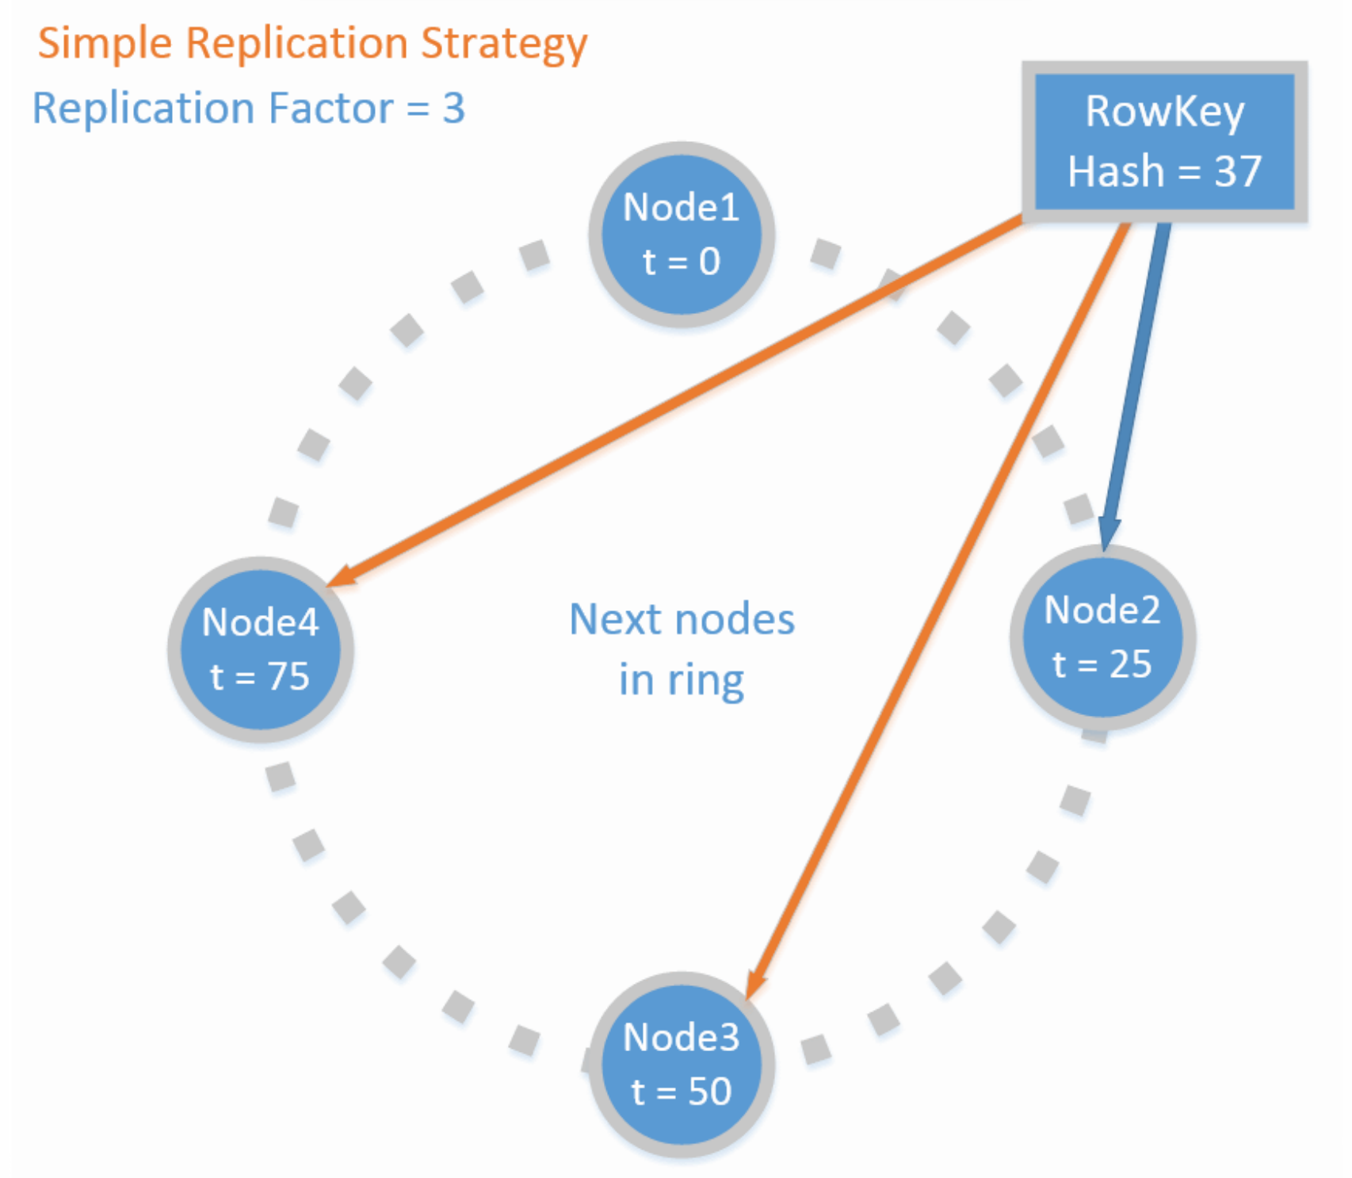
CASSANDRA DEMO #1 – AVAILABILITY
$ docker stop node1
cqlsh> CONSISTENCY QUORUM;
$ nodetool removenode <hash>

Slide 9
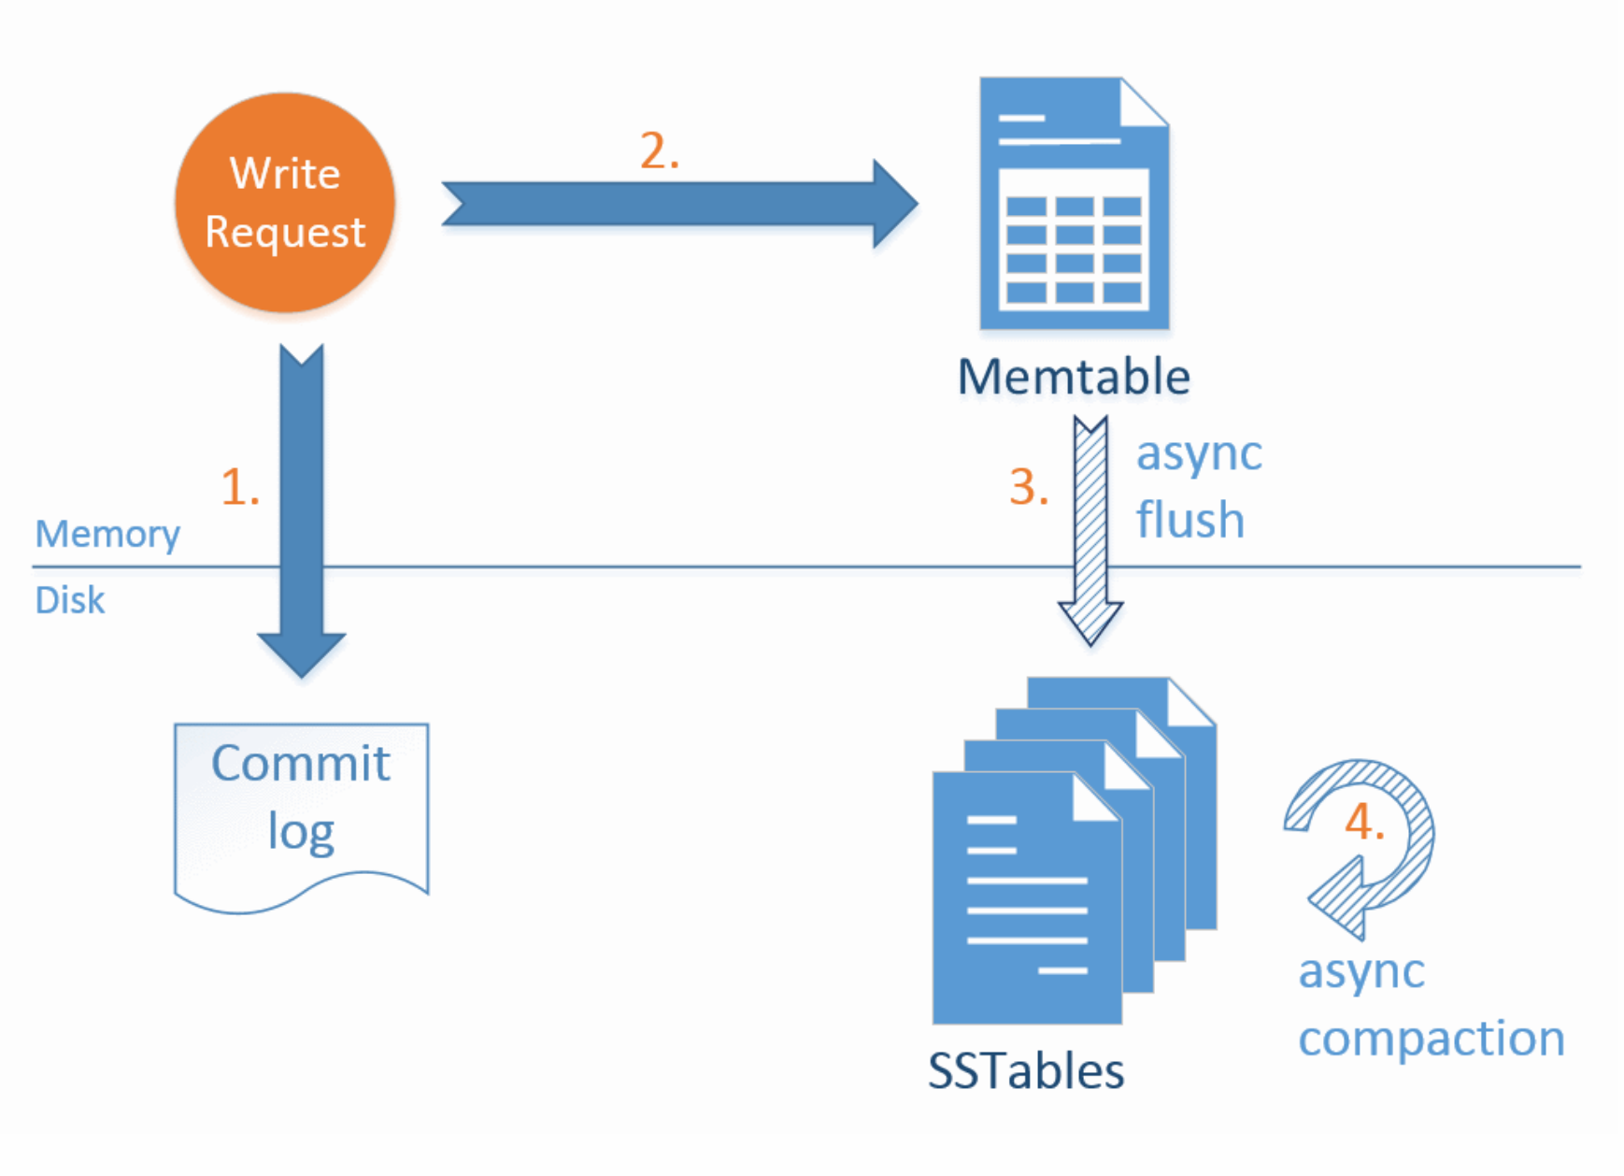
CASSANDRA DEMO #2 – WRITE PATH
nodetool flush
nodetool compact

Slide 10

Questions?

